Slide 1
R Programming Training (Basic)
Introduction to R

Slide 2
What is R Programming Language?
R is an open-source programming language that facilitates statistical computing and graphical libraries.
Being open-source, R enjoys community support of avid developers who work on releasing new packages, updating R and making it a steadfast programming package for Data Science.
With the help of R, one can perform various statistical operations that any other statistical program can handle.
You can obtain it for free from the website www.r-project.org.
It is driven by command lines.
Each command is executed when the user enters them into the prompt.
The base installation provides hundred of data management, statistical and graphical functions but some of its most powerful features come from packages (extension)
All the packages are available for free at the R project website called CRAN. It contains over 18,000 packages in R

Slide 3
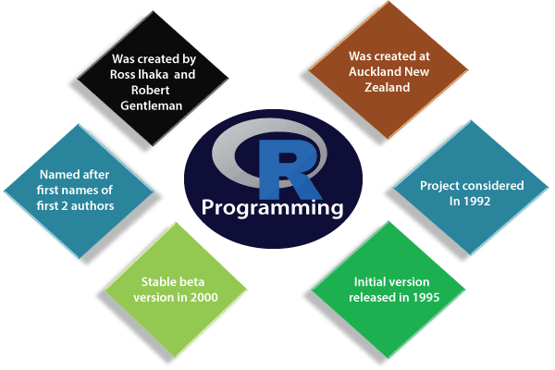
History of R
R was conceived at the Bell Laboratories (Bell Labs) in New Jersey, US by John Chambers, Doug Dunn, Jean McRae and Judy Schilling in 1976.
R was developed as an extension as well as an implementation of S programming language.
The R project was developed by Ross Ihaka and Robert Gentleman and released in 1992, its first version in 1995 (Free and Open Source Software) under GNU General Public License and
The Comprehensive R Archive Network (CRAN) was launched in 1997. CRANE stores R’s executable files, source code, documentation and packages contributed by users. It as more than 101 mirrors
First stable beta version released in 2000.
R Foundation was founded as a non-profit organization to support R project.

Slide 4
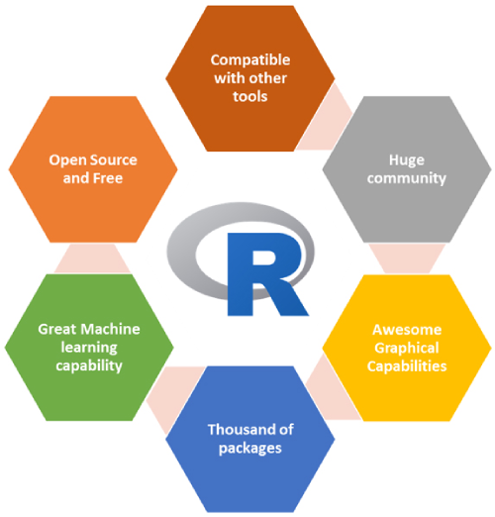
Why Learn R ?
Most commercial statistical software costs $$ but R is free owing to its open-source GNU licensing and can be installed by anyone.
R runs on a wider array of platforms/operating systems (Windows, MacOS X and Unix)
R can perform statistical analysis, data management, exploration, analysis as well as machine learning. We can create objects, functions and packages in it.
It contains advanced statistical routines not yet available in other statistical software.
R has state-of-the-art graphic capabilities to visualize complex data. With the packages like ggplot2, plotly, users can make visually appealing and elegant visualizations.
R is most widely used by the various industries. Only the academic avenues in the past made use of R but industries are now using R as their primary tool for statistical modeling. (health, finance, banking, manufacturing and many more.)
R programmers for many roles like data analysts, business analysts, data visualization experts, and business intelligence experts.
If you don’t want to learn a new language, a variety of graphic user interfaces (GUIs) are available !!!

Slide 5
Features of R Programming
R is a comprehensive programming language that provides support for procedural programming involving functions as well as object-oriented programming with generic functions.
There are more than 18,000 packages in the repository of R programming. With these packages, one can make use of functions to facilitate easier programming.
R facilitates complex operations with vectors, arrays, data frames as well as other data objects that have varying sizes.
R can be easily integrated with many other technologies and frameworks like Hadoop and HDFS. C, C++, Python, Java, FORTRAN, and JavaScript.
As discussed in the above section, R has extensive community support that provides technical assistance, seminars and several boot camps to get you started with R.
Effective data handling and storage facility, powerful, extensible software

Slide 6
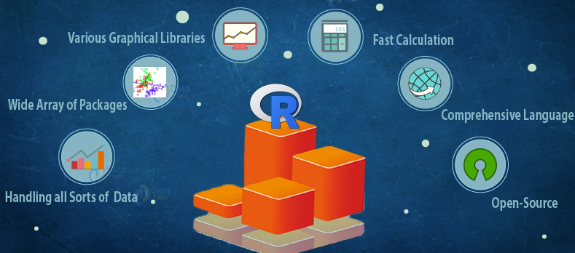
How R is better than other programs?
Graphical Libraries – R stays ahead of the curve through its aesthetic graphical libraries. Libraries like ggplot2, plotly facilitate appealing libraries for making well-defined plots.
Availability / Cost – R is completely free to use which means widespread availability.
Advancement in Tool – R supports various advanced tools and features that allow you to build robust statistical models.
Job Scenario – As stated above, R is the primary tool for Data Science. With the immense growth in Data Science and rise in demand, R has become the most in-demand programming language of the world today.
Customer Service Support and Community – With R, you can enjoy strong community support.
Portability – R is highly portable. Many different programming languages and software frameworks can easily combine with the R environment for the best results.

Slide 7
Applications of R Programming
R is used in finance and banking sectors for detecting fraud, reducing customer churn rate and for making future decisions.
R is also used by bioinformatics to analyze strands of genetic sequences, for performing drug discovery and also in computational neuroscience.
R is used in social media analysis to discover potential customers in online advertising. Companies also use social media information to analyze customer sentiments for making their products better.
E-Commerce companies make use of R to analyze the purchases made by the customers as well as their feedbacks.
Manufacturing companies use R to analyze customer feedback. They also use it to predict future demand to adjust their manufacturing speeds and maximize profits.
It is widely used in academic community doing research.

Slide 8

Applications of R
Academics: R is a programming language created for statistical computing. It is widely used by students, professors, and researchers for developing statistical models and also for analyzing large results from studies and surveys.
Healthcare: R is the most popular analysis tool used for pre-clinical drug trials. New medicines and medical procedures are tested using R. It is also used to analyze genetic sequences to identify genetic anomalies and to analyze various chemical compositions to identify their uses and side-effects.
Finance: The finance sector deals with a lot of statistics. R is the most preferred technology for this purpose among them. They use it to identify and predict market trends. They also use it to calculate statistics like annual profits or loss, recovery models, etc.
Banking: Bank uses R for risk modeling and mortgage rate calculation. They also use it for credit risk modeling.
IT Sector: IT companies use R for business intelligence and to develop statistical computing software. They also use R to devise their business strategy.
Manufacturing: Manufacturing companies use R to predict market demand. They alter their production according to the demand predictions. They also design their products according to sentiment analysis results of their customer reviews.
Social Media: Social media companies use R for machine learning and sentiment analysis research. They analyze their users’ posts and activities to draw insights from it and try to improve their user experience according to the results.

Slide 9
Advantages of R Programming language
Performance: R is faster as compared with many proprietary packages
Cost: The R programming language is open-source software. Therefore, anyone can use and change it.
Community: Vibrant and active community generating new content and answers to questions.Due to its open-source nature, anyone can fix the bugs, enhance the code and work on new packages.
Adaptability: Thousands of packages available to handle specialized data analysis tasks, to customize graphical displays, to interface with other programs /software
Flexibility: Code is often hidden in other proprietary language, in R it is much easier to make changes.

Slide 10
Pros of R
Open Source : R is an open-source programming language. This means that anyone can work with R without any need for a license or a fee. Furthermore, you can contribute towards the development of R by customizing its packages, developing new ones and resolving issues.
Exemplary Support for Data Wrangling : R provides exemplary support for data wrangling. The packages like dplyr, readr are capable of transforming messy data into a structured form.
The Array of Packages : R has a vast array of packages. With over 10,000 packages in the CRAN repository, the number is constantly growing. These packages appeal to all the areas of industry.
Quality Plotting and Graphing : R facilitates quality plotting and graphing. The popular libraries like ggplot2 and plotly advocate for aesthetic and visually appealing graphs that set R apart from other programming languages.

Slide 11
Pros of R
Highly Compatible : R is highly compatible and can be paired with many other programming languages like C, C++, Java, and Python. It can also be integrated with technologies like Hadoop and various other database management systems as well.
Platform Independent : R is a platform-independent language. It is a cross-platform programming language, meaning that it can be run quite easily on Windows, Linux, and Mac.
Eye-Catching Reports : With packages like Shiny and Markdown, reporting the results of an analysis is extremely easy with R. You can make reports with the data, plots and R scripts embedded in them. You can even make interactive web apps that allow the user to play with the results and the data.
Machine Learning Operations : R provides various facilities for carrying out machine learning operations like classification, regression and also provides features for developing artificial neural networks.
Statistics : R is prominently known as the lingua franca of statistics. This is the main reason as to why R is dominant among other programming languages for developing statistical tools.
Continuously Growing……

Slide 12
Cons of R
Weak Origin : R shares its origin with a much older programming language “S”. This means that it’s base package does not have support for dynamic or 3D graphics. With common packages of R like ggplot2 and Plotly, it is possible to create dynamic, 3D as well as animated graphics.
Complicated Language : R is not an easy language to learn. It has a steep learning curve. Due to this, people who do not have prior programming experience may find it difficult to learn R.
Lesser Speed : R packages and the R programming language is much slower than other languages like MATLAB and Python.
Spread Across various Packages : The algorithms in R are spread across different packages. Programmers without prior knowledge of packages may find it difficult to implement algorithms.

Slide 14
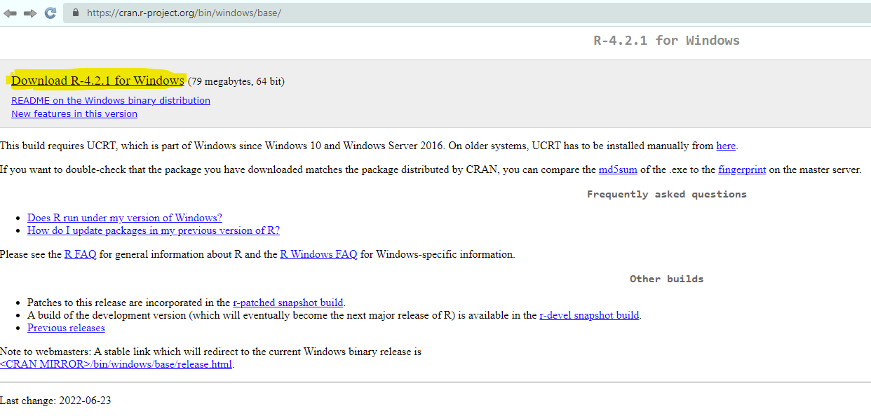
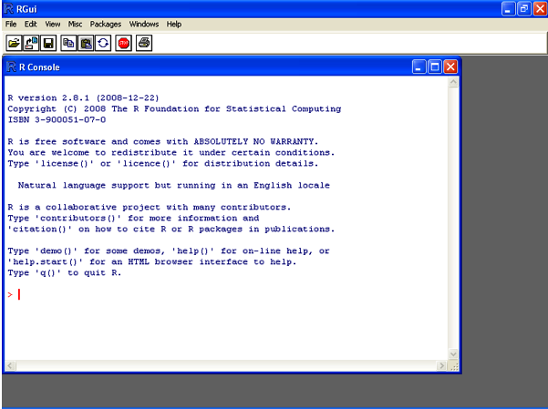
Getting R
Downloading and installation of R
Download binary files for major operating systems https://cloud.r-project.org/
R GUI is the standard GUI platform for working in R.
The R Console Window forms an essential part of the R GUI. In this window, we input various instructions, scripts and several other important operations
Source :https://www.oreilly.com/library/view/r-in-a/9781449358204/ch02s01.html

Slide 15
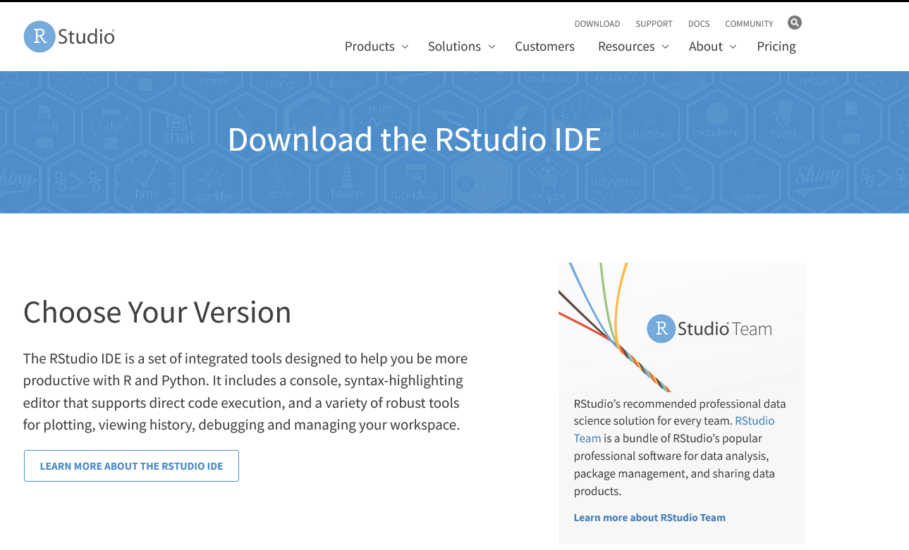
RStudio
RStudio is an integrated Development Environment (IDE) which allows us to interact with R.
Can facilitate extensive code editing, code completion, syntax highlighting and development.
Easy to manage multiple working directories using projects
Integrated R help and documentation, jump to function definitions
It can also be accessed over the web and is cross-platform in nature.
It facilitates automatic checking of updates so that you don’t have to check for them manually.
It provides support for recovery in case of file loss.
With RStudio, you can manage the data more efficiently.
Rstudio is highly customizable
Downloading and installation of RStudio
RStudio Desktop - Posit
We will use Rstudio for this training

Slide 16
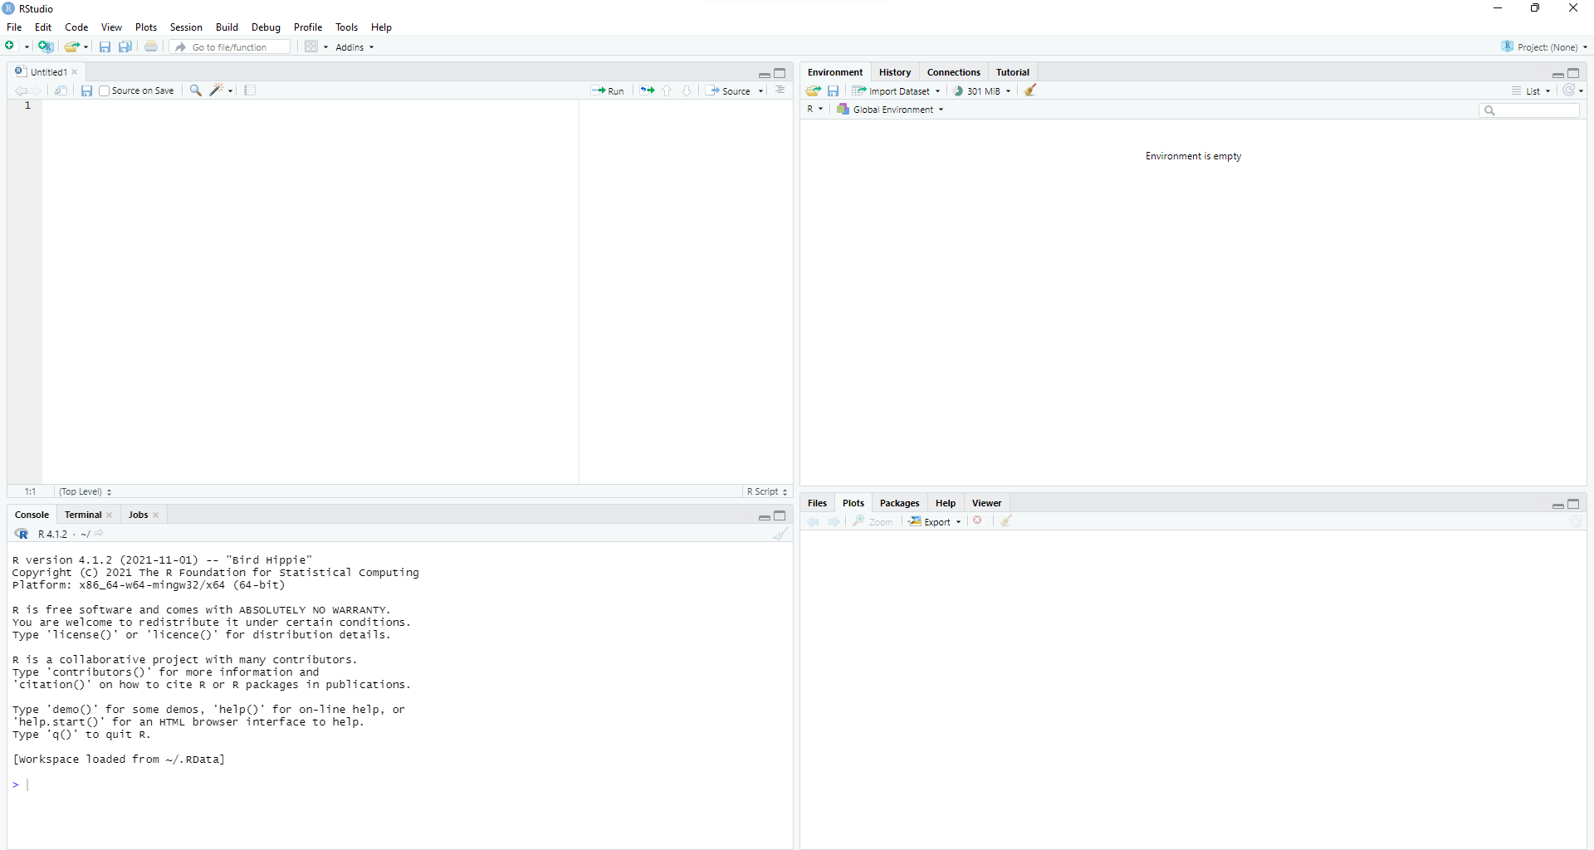
Components of RStudio
SOURCE
HISTORY/ENVIRONMENT
In the top left corner of the screen is the text editor that allows you to work within source scripting. You can enter multiple lines in this source. Furthermore, users can save the R scripts to files that are stored in local memory.
In the top right corner, you will find the R workspace and the history window. Holds information about the workspace, command history, files in the current folder.
This is present on the bottom left corner of the main window of R Studio. It facilitates interactive scripting in R. Just like Standard R console
FIGURES/FILES/HELP
In the lower right corner, it displays plots, package information, help files
CONSOLE

Slide 17
Scripting in R
We will create a script to print “Hello world!” in R.
To create scripts in R, you need to perform the following steps:
Here in R, you will have to enclose some commands in print() to get the same output as on the command line. So you need to type below command: This takes “Hello World” as input in R.
Print(“Hello World”)
Print(“Hello Birendranagar, Surkhet”)
In order to execute a selected line of code: Select the line(s) of code, then press Ctrl + R in R GUI and Ctrl + Enter in RStudio.
In order to execute the entire script: In the case of RStudio, Hold and press Ctrl+Shift+ Enter.

Slide 18
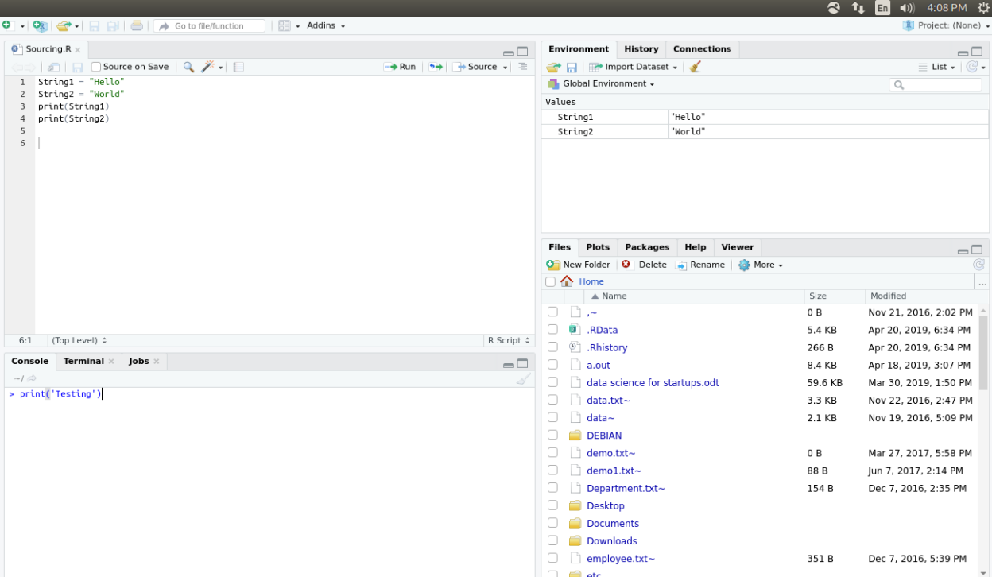
Basic Interaction with R Console
The most common form of interaction with R is through the command line in the console.

Slide 19
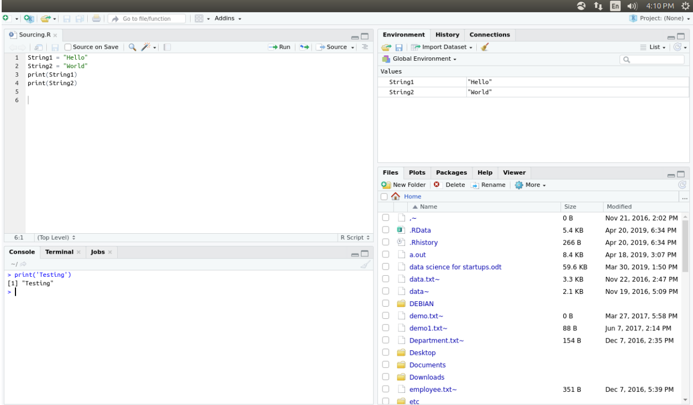
Output ::

Slide 20
The workspace
Current R working environment and includes any user-defined objects (vectors, matrices, functions, data frames, and lists).
At the end of an R session, you can save an image of the current workspace that’s automatically reloaded the next time R starts. Commands are entered interactively at the R user prompt.
The current working directory is the directory from which R will read files and to which it will save results by default.
getwd () >> what the current working directory is
setwd () >> set the current working directory [If you need to input a file that isn’t in the current working directory, use the full pathname in the call]

Slide 21
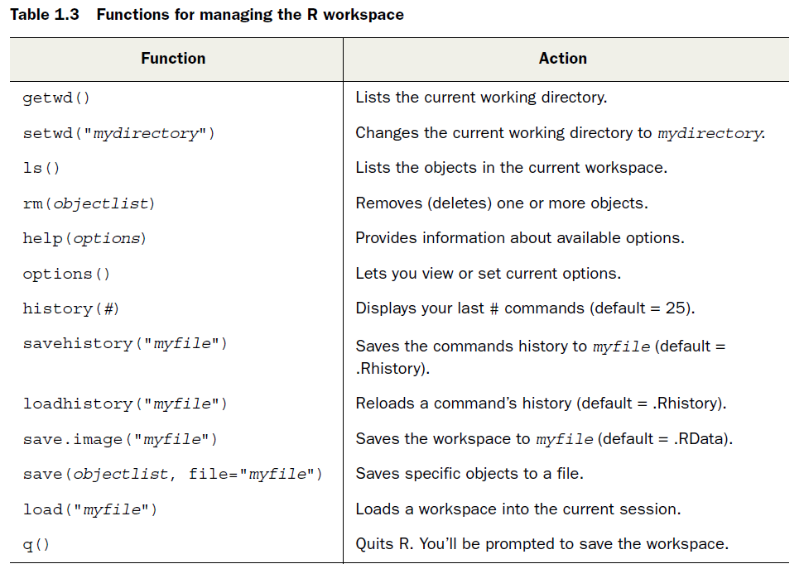
The workspace
R in action second edition

Slide 22
The workspace
setwd("C:/training/day1") >> Current working directory is set
options() >> Option settings are displayed
options(digits=3) >> number are formatted to print with 3 digits after decimal place
x <- runif(20) >> a vector with 20 uniform random variates is created
summary(x) >> summary statistics produced
hist(x) >> a histogram based on this data is generated
q() >> users prompt to save their workspace

Slide 23
R Packages (Libraries)
Extensive capabilities are in R but exciting features are outside the box.
Packages are user-contributed modules
Packages comprise of R functions, data and compiled code that are present in a well-defined format. The location where the packages are installed is known as a library.
The function .libPaths()shows you where your library is located, and the function
library() shows you what packages you’ve saved in your library.
R comes with a standard set of packages. Others are available for download and installation.
R comes with a standard set of packages (including base, datasets, utils,
grDevices, graphics, stats, and methods)
If we will install it once, we have to be load it into the session to be used.
Open an R session and type this in the command line to install an R package. install.packages("<the package's name>").
R package will be downloaded from CRAN. http://cran.r-project.org/web/packages

Slide 24
R Packages (Libraries)
There are thousands of useful R packages for us, but navigating them all can be a challenge. Here are a few packages, we recommend to a beginner:
Tidyversre: tidyverse is a collection of packages that are useful for many tasks like data management, data reshaping, data formatting, memory management, etc.
Dplyr : Dplyr is used for editing, modification of huge datasets.
ggplot2: the ggplot2 package is the most popular graphics package in R. It extends R’s graphical capabilities by a large margin able to make static, dynamic as well as animated graphics with simple commands.
Installr: the installr package is highly useful for installing, updating and managing versions of R, RStudio, and R packages.
Stringr: Stringr is a package very popular for its string manipulation functions. Stringr functions are much easier to use and more powerful than the base R functions.

Slide 25
Installing R Packages
In order to use RStudio, we require a particular package to be installed. Further, follow the instructions below:
Run RStudio
Afterwards, click on the packages tab in the bottom-right section. Once, you complete this, click install.
The dialog box will appear. In the install packages dialog, write the package name for which you want to install the Packages field. And then click install. This will install the package you searched for and give you a list of matching package based on your package text.

Slide 26
Package Documentation
Every good package consists of documentation. Users will not know how to make sense of the package. Documentation is also useful for future-you, and for developers extending your package.
Object documentation is a type of reference documentation. It works like a dictionary.
If you are acquainted with the name of the object, documentation is really helpful.

Slide 27

Updating R Packages
Install.packages() is used to install any package of CRAN. For example: Typing Install.packages(“ggplot2”) in the console will install the latest package of ggplot2.
You can also update any out of date package with the help of the update.packages() function.

Slide 28
Loading a package
library (ggplot2) >> use ggplot2 package but you must have installed a package before you can load it
You’ll only have to load the package once in a given session. If desired, you can customize your startup environment to automatically load the packages you use most often.
When you load a package, a new set of functions and datasets becomes available
Entering help(package="package_name") provides a brief description of the package and an index of the functions and datasets included

Slide 29
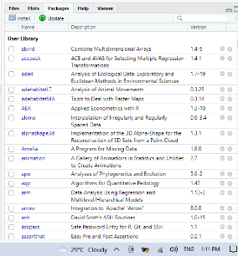
Uninstalling Packages
remove.packages ()
X inside a gray circle on the right of the package descriptions in RStudio’s Packages pane

Slide 30
Building a package
You can building a package and share with the community through CRAN.
All packages submitted to CRAN (or Bioconductor) must follow specific guidelines, including the folder structure of the package, inclusion of DESCRIPTION and NAMESPACE files and proper help files.

Slide 31
Conclusion
Packages make up the backbone of the R community and experience.
They are often considered what makes working with R so desirable. This is how the community makes its work and so many of the statistical techniques, available to the world.
With such a large number of packages (18000+), finding the right one can be overwhelming.

Slide 32
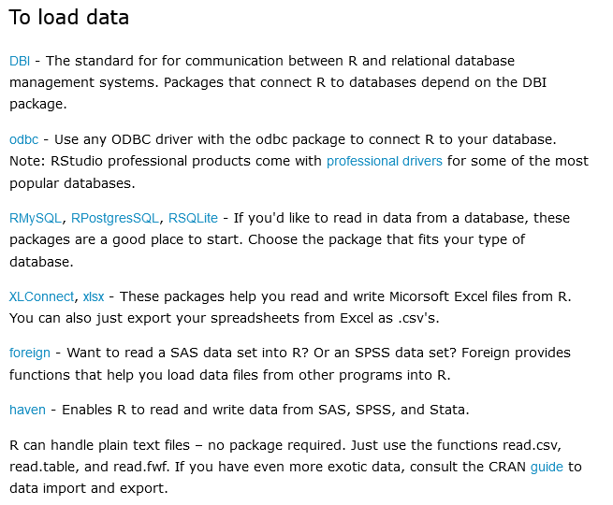
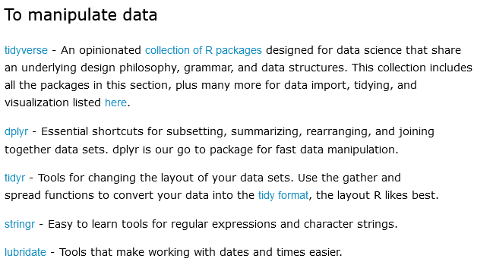
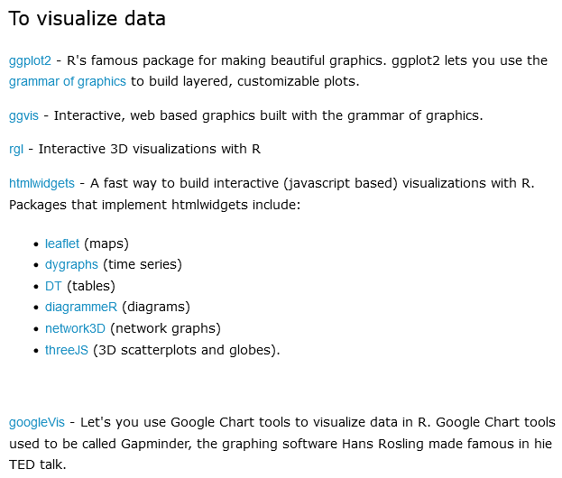
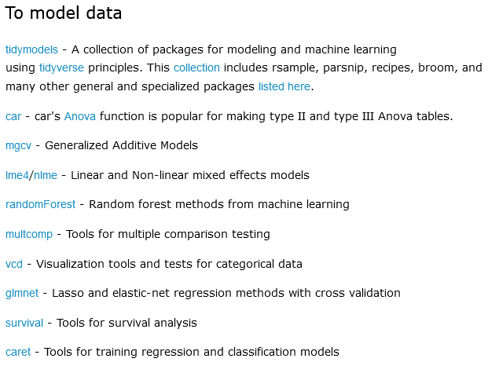
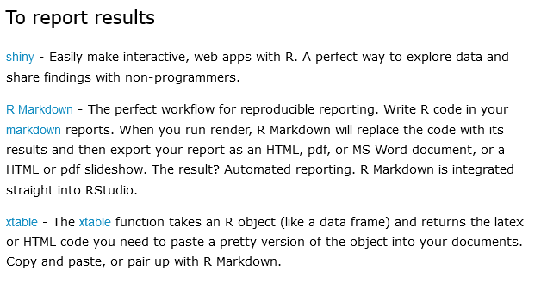
Finding right packages

Slide 33
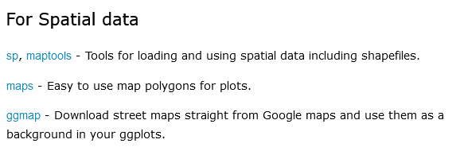
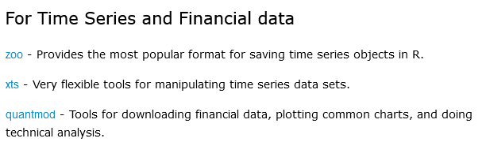
Finding right packages
https://support.rstudio.com/hc/en-us/articles/201057987-Quick-list-of-useful-R-packages
https://www.computerworld.com/article/2921176/great-r-packages-for-data-import-wrangling-visualization.html
https://cran.r-project.org/web/views/Spatial.html
https://www.zevross.com/blog/2019/05/01/unscientific-list-of-popular-r-packages-for-spatial-analysis/
https://urbandemographics.blogspot.com/2018/08/assorted-r-packages-for-spatial-analysis.html

Slide 34
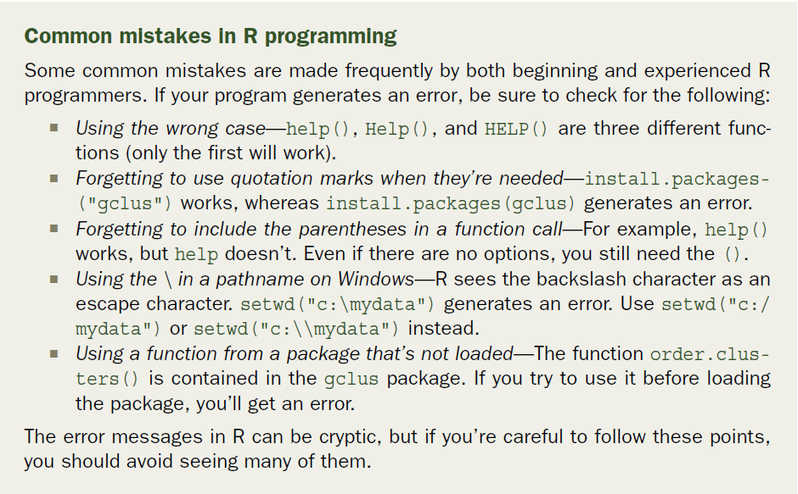
Common mistakes in R programming
R in action second edition

Slide 36
Basics of R
Basic Math
Variables
Data types
Vectors
Matrices
Arrays
Data frames
Factors
Lists
Calling functions
Missing data

Slide 37

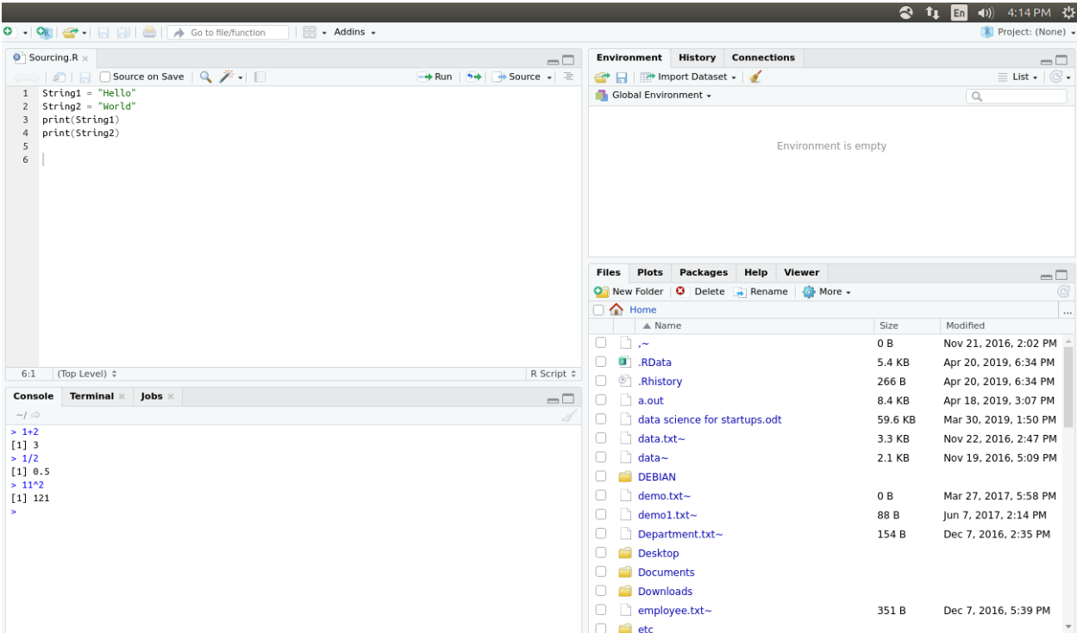
Basic Math (Using R as a Calculator)
R can do basic math (Users type expressions to the R interpreter).
R responds by computing and printing the answers.
R follows basic order of operations: Parenthesis, Exponents, Multiplication,
Division, Addition and Subtraction (PEMDAS).

Slide 38
Variables
Variables are an integral part of any programming language and R offers a great deal of flexibility.
User can assign variable in R.
The valid assignment operators are <- and =, with the first being preferred
x <- 2
x
y <- 5
y
a<- b <- 5
a
assign("i", 3) using assign function.
i
Removing variable
rm(i) using rm function
# now it is gone

Slide 39
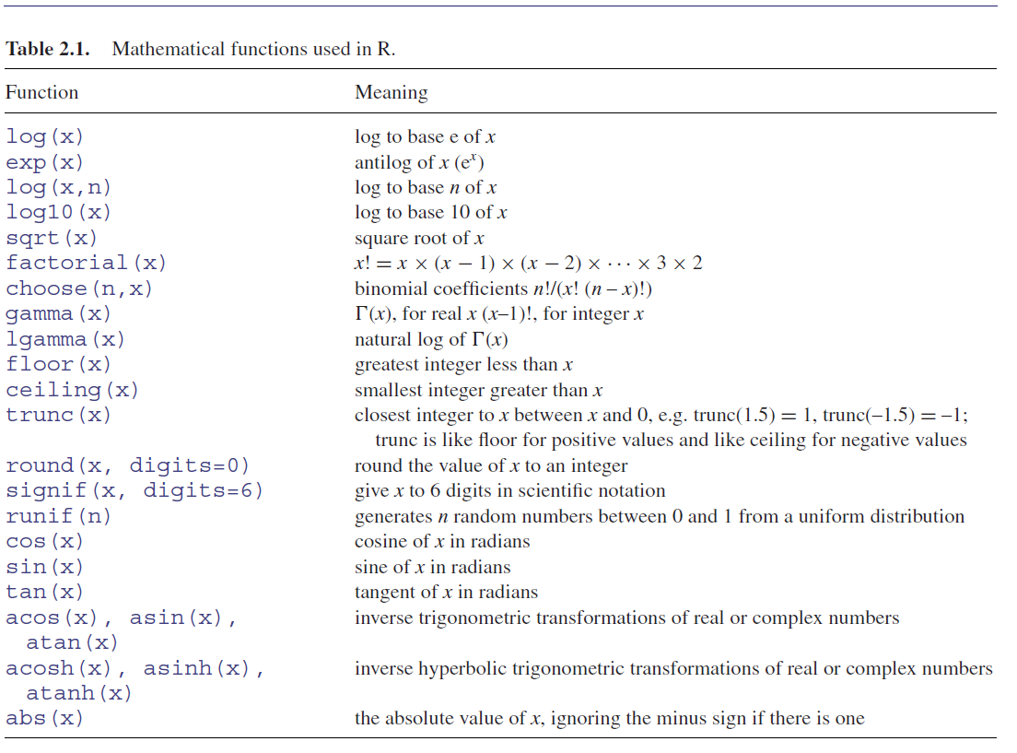
Mathematical functions used in R
pi
sin(pi/2)
cos(pi/2)

Slide 40
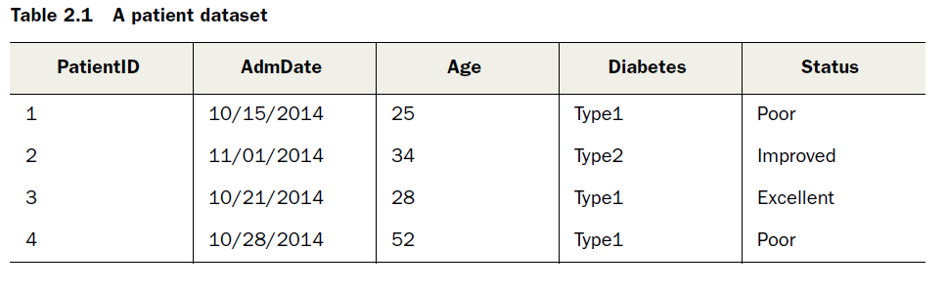
Datasets
A dataset is usually a rectangular array of data with rows representing observations (1,2,3) and columns (Age, Diabetes, Status) representing variables.
Rows= observations = records (data mining) = examples(Machine Learning)
Columns = variables = fields (data mining) = attributes(Machine Learning)
PatientID is a row or case identifier, AdmDate is a date variable, Age is a continuous
variable, Diabetes is a nominal variable, and Status is an ordinal variable

Slide 41
R Data Types
For correct processing, a programming language must know what can and cannot be done to a particular value. For example, addition cannot be performed on the words ‘hello’ and ‘world’.
Similarly, you cannot change the numbers 1 and -34.5 from lower to uppercase. Due to this, R has a feature called the data types.
Different kinds of values are assigned different data types that help differentiate them
R provides the class() and typeof() functions to find out what is the class and type of any variable.
R has five data types which are:
Numeric
Integers
Complex
Logical
Characters

Slide 42
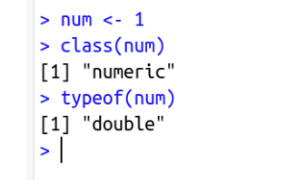
Numeric Data
The numeric data type is for numeric values. It is the default data type for numbers in R. It is the most common type in R. (Similar to float or double in other languages.
Examples of numeric values would be integers, and decimals, both positive or negative or zero e.g., 1, 34.5, 3.145, -24, -45.003, etc.
Testing whether a variable is numeric use this function is.numeric(x)
num <- 1
class(num)
typeof(num)
Note: When R stores a number in a variable, it converts the number into a ‘double’ value or a decimal type with at least two decimal places. This means that a value such as ’1’ is stored as 1.00 with a type of double and a class of numeric.

Slide 43
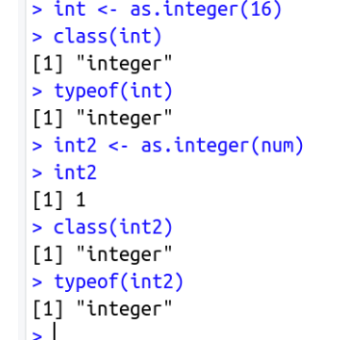
Integers Data Type
The Integer data type is used for integer values. The integer data type is commonly used for discrete only values like unique ids. We can store as well as convert a value into an integer type using the as.integer() function.
int <- as.integer(16)
class(int)
typeof(int)
int2 <- as.integer(num)
int2
class(int2)
typeof(int2)

Slide 44
Numeric vs Integer Data
If the data consists of only numbers, like decimals, whole numbers, then we call it NUMERIC DATA. In numeric data, the numbers can be positive or negative. If the data consists only of whole numbers, it is called as INTEGER. Integers too may take negative or positive values.
A whole number is simply any positive number that does not include a fractional or decimal part. This means that, for example, the numbers 0, 1, 2, 3, 4, 5, 6, and 7 are all whole numbers. Numbers such as -3, 2.7, or 3 ½ are not whole numbers.

Slide 45
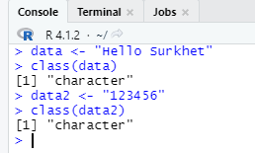
Character Data
The character data type stores character values or strings.
Strings in R can contain the alphabet, numbers, and symbols. The easiest way to denote that a value is of character type in R is to wrap the value inside single or double inverted commas.
Characters are case sensitive as DATA and Data are different in R.
R has two primary ways of handling character data: character and factor
char <- "Hello Surkhet"
class(char)
typeof(char)
We can also use the as.character() function to store a value as a character or to convert a value to the character data type.

Slide 46
Dates
Dealing with dates and times is complicated in R as R has numerous different types of dates. The most useful are Date and POSIXct.
Date stores just a date while POSIXct stores a date and time
date2 <- as.POSIXct ("2012-06-28 17:42”)
date2
(1] ”2012-06-28 17:42:00 EDT"
>class (date 2)
[11 “POSTXct” "POSIXt"
>as.numeric (date2)
(1) 1340919720
date <- as.Date ("2012-06-28")
>date1
[11 2012-06-28
>class (date)
(1) "Date"
>as.numeric (date)
(1] 15519

Slide 47
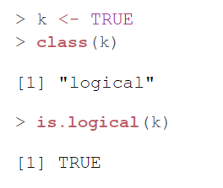
Logical
Logicals are a way of representing data that can be either TRUE or FALSE. Numerically, TRUE is the same as 1 and FALSE is the same as 0.
logi <- FALSE
class(logi)
typeof(logi)

Slide 48
Converting Data Types in R
Conversion into Numeric
We can use the as.numeric function to convert the values of other data types into numerical values. The conversion follows a few rules, which are:
To convert an integer value into a numeric, we can use the as.numeric function.
Logical values can be converted into numeric as well by the function. The TRUE value is converted to 1, and FALSE is converted to 0.
Character values can similarly be converted into numerical values but if the string contains letters, alphabets, and symbols then the numeric value becomes NA.

Slide 49
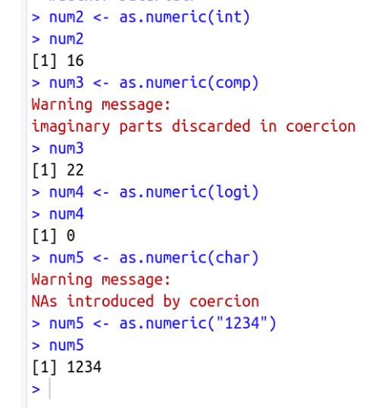
num2 <- as.numeric(int)
num2
num3 <- as.numeric(comp)
num3
num4 <- as.numeric(logi)
num4
num5 <- as.numeric(char)
num5 <- as.numeric("1234")
num5

Slide 50
Conversion into Integer
The as.integer function can convert the values of other data types into integer values according to the following rules:
Numeric values can be converted into an integer using the function. This removes any decimal values from the number.
Complex values can also be converted into integers. The function removes the imaginary parts of the number.
The conversion from logical values to integers is similar to the conversion of logical values to numerics. TRUE is converted to 1, and FALSE is converted to 0.
Character values can be converted into integers as well by using the as.integer function. This conversion follows the same rules as the character to numeric conversion.

Slide 51
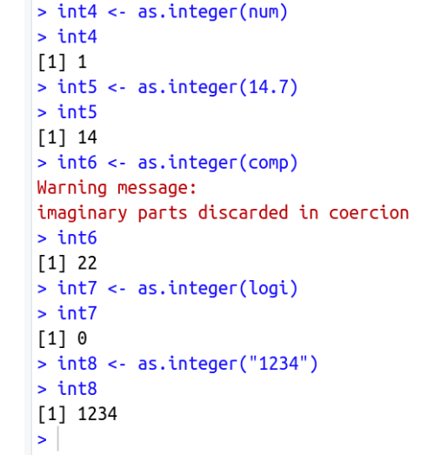
int4 <- as.integer(num)
int4
int5 <- as.integer(14.7)
int5
int6 <- as.integer(comp)
int6
int7 <- as.integer(logi)
int7
int8 <- as.integer("1234")
int8

Slide 52
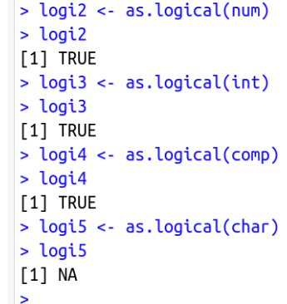
Conversion into Logical
Conversion into logical data type can be done by using the as.logical function, by following the given rules:
Numeric, integer, and complex values can be converted into logical values, but the function returns FALSE if the value is zero and TRUE if it is anything else.
Character values when converted by the as.logical function, always return NA.
logi2 <- as.logical(num)
logi2
logi3 <- as.logical(int)
logi3
logi4 <- as.logical(comp)
logi4
logi5 <- as.logical(char)
logi5

Slide 53
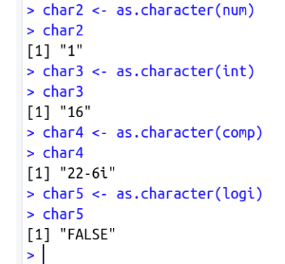
Conversion into character
We can convert a value of any data type into character data type using the as.character function. The function converts the original value into a character string.
char2 <- as.character(num)
char2
char3 <- as.character(int)
char3
char4 <- as.character(comp)
char4
char5 <- as.character(logi)
char5
Note: NA values have no type and therefore stay as such when converted to any type.

Slide 54
Summary
We learned about the various types of data that R supports. These data types are the basic building blocks of any kind of data in R programming. They assign meaning to values in R and also tell R how to process and how not to process them.

Slide 55
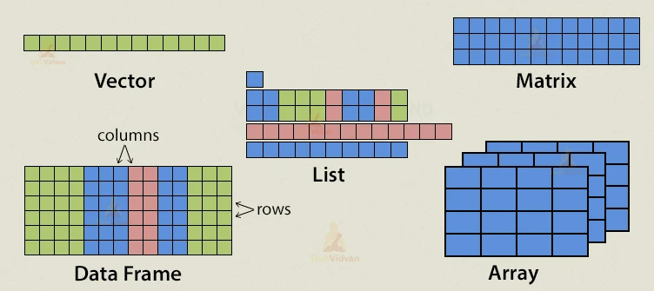
Data Structures in R
R has a wide variety of objects for holding data, including scalars, vectors, matrices, arrays, data frames, and lists
They differ in terms of the type of data they can hold, how they’re created, their structural complexity, and the notation used to identify and access individual elements.
Source : https://techvidvan.com/tutorials/r-data-structures/

Slide 56
Vector
Vector is the most basic data structure in R programming language.
Vectors are one-dimensional arrays that can hold numeric data, character data, or logical data.
A vector is a collection of elements, all of the same type
The combine function c() is used to form the vector
For instance, a <- c(1, 3, 2,1, 5) is a vector consisting of the numbers 1; 3; 2; 1; 5, in that order. [NUMERIC VECTOR]
Similarly, b <- c("R", "Excel", "SAS", "Excel") is a vector of the character elements,
“R”, “Excel”, “SAS”, and “Excel”. [CHARACTER VECTOR]
A vector cannot be of mixed type.
Scalars are one-element vectors f <- 3, g <- “boy”, h <- TRUE

Slide 57
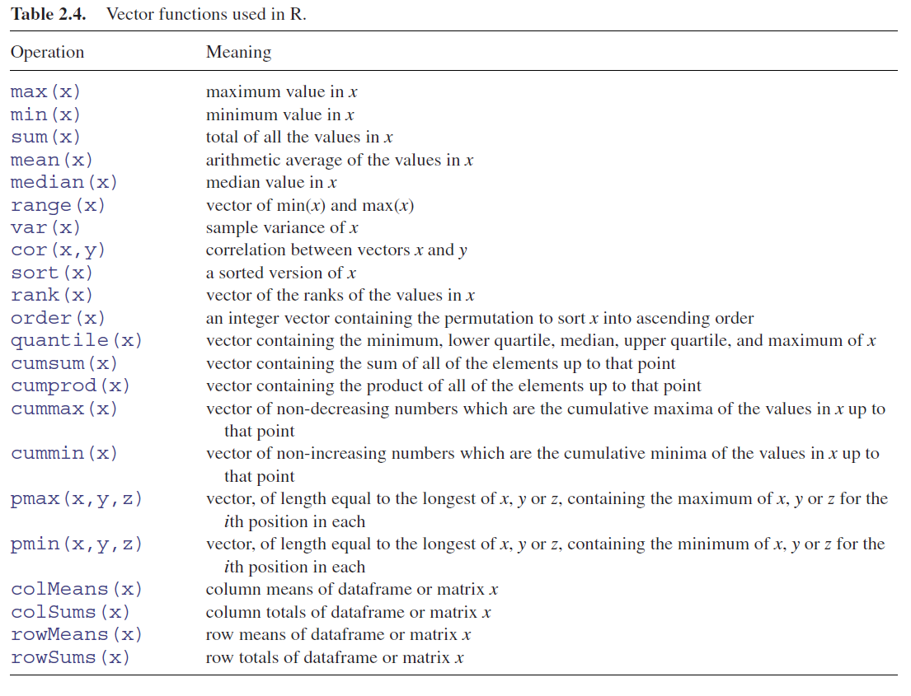
Vector functions
One of R’s great strengths is its ability to evaluate functions over entire vectors, thereby avoiding the need for loops and subscripts.
y <- c(8,3,5,7,6,6,8,9,2,3,9,4,10,4,11)
mean(y)
[1] 6.333333
range(y)
[1] 2 11

Slide 58
Vector operations
Now that we have a vector of the first ten numbers, we might want to multiply each
element by 3.
x <- c(1, 2, 3, 4, 5, 6, 7, 8, 9, 10)
> x
[1] 1 2 3 4 5 6 7 8 9 10
x * 3
[1] 3 6 9 12 15 18 21 24 27 30
x + 2
[1] 3 4 5 6 7 8 9 10 11 12
sqrt(x)
mean(x)

Slide 59
Missing Data
Often we will have data that has missing values for any number of reasons.
R uses NA. NA will often be seen as just another element of a vector.
is.na tests each element of a vector for missingness.
z <- c(1, 2, NA, 8, 3, NA, 3)
> z
[1] 1 2 NA 8 3 NA 3
> is.na(z)
[1] FALSE FALSE TRUE FALSE FALSE TRUE FALSE
> mean(z)
[1] NA
> mean(z, na.rm=TRUE)
[1] 3.4
Try with other functions sum, min, max, var, sd and other functions

Slide 60
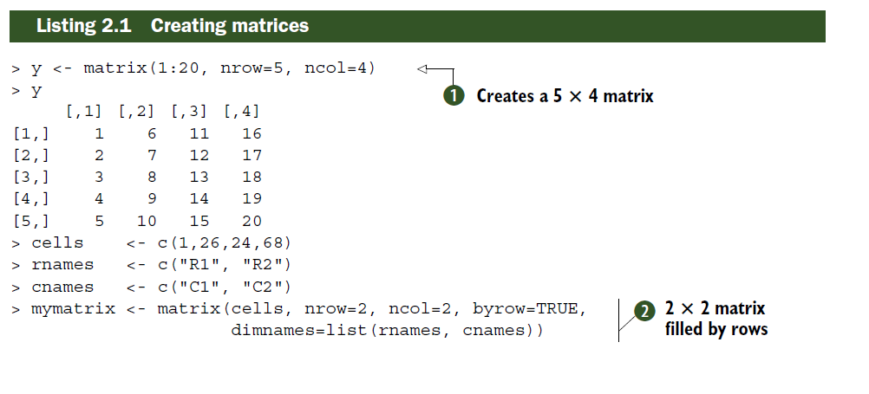
Matrix
A matrix is a two-dimensional rectangular data set in which each element has the same mode (numeric, character, or logical)
In addition, a matrix is a collection of numbers arranged into a fixed number of rows and columns. Usually, the numbers are the real numbers.
By using a matrix function, we can reproduce a memory representation of the matrix in R.
# create a 5x2 matrix
A <- matrix(1:10, nrow=5)
A
B <- matrix(21:30, nrow=5)
B
nrow (A)
ncol (A)
dim (A)

Slide 61
Matrix
Matrix can also have row and column names.
> colnames(A)
NULL
> rownames(A)
NULL
> colnames(A) <- c("Left", "Right")
> rownames(A) <- c("1st", "2nd", "3rd", "4th", "5th")
> colnames(B)
NULL
> rownames(B)
NULL
> colnames(B) <- c("First", "Second")
> rownames(B) <- c("One", "Two", "Three", "Four", "Five")
# add two matrices
A+ B
#transpose to flip the row and column names
t(A)

Slide 62
Uses of Matrices
Adding (mat1 + mat2)
Subtracting (mat1-mat2)
Multiply by Constant (4 * mat1)
Diving (mat1 / mat2)
Transposing (t(mat1))
Identity Matrix (diag(4))

Slide 63
Applications of Matrices
Matrices are used for carrying out geological surveys. We can represent information in the form of matrices that can be used for plotting graphs, performing statistical operations, etc.
To represent the real-world data is like traits of people’s population. They are the best representation method for plotting common survey things.
In robotics and automation, matrices are the best elements for the robot movements.
Matrices are used in calculating the gross domestic products in economics. Therefore, it helps in calculating goods product efficiency.
In computer-based applications, matrices play a vital role in the projection of a three-dimensional image into a two-dimensional screen creating realistic seeming motions.
In physical related applications, matrices can be applied in the study of an electrical circuit.

Slide 64
R Array
In R Programming, arrays are multi-dimensional Data structures.
In an array, data is stored in the form of matrices, row, and as well as in columns. We can use the matrix level, row index, and column index to access the matrix elements.
Arrays in R are the data objects which can store data in more than two dimensions.
An array is created using the array() function.
We can use vectors as input. To create an array, we can use these values in the dim parameter.

Slide 65
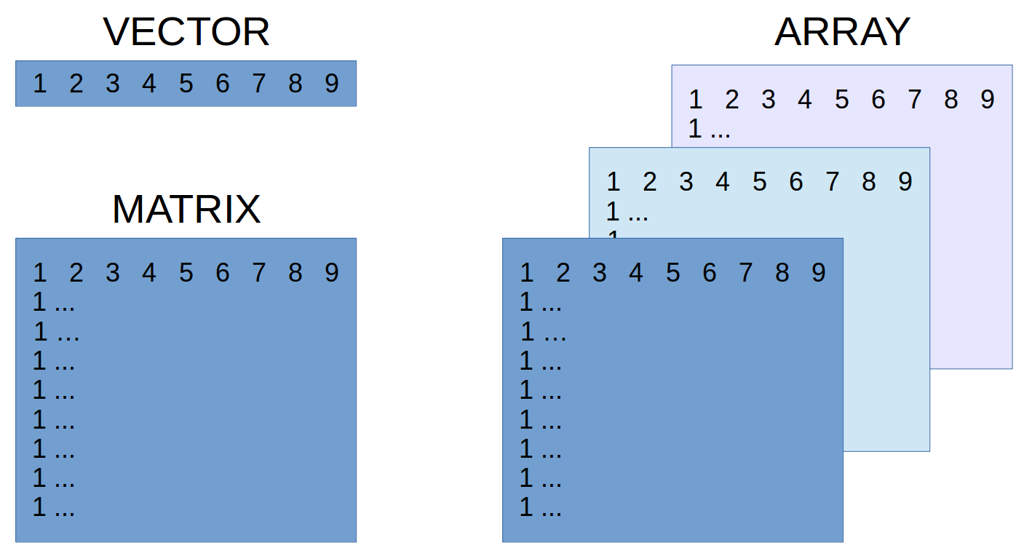
R Array Examples
An array is essentially a multidimensional vector. Similar to matrix but have more than two dimensions. It must all be of the same type, and individual elements are accessed in a similar fashion using square brackets. The first element is the row index, the second is the column index and the remaining elements are for outer dimensions.
myarray <- array(vector, dimensions, dimnames)
theArray <- array(1:12, dim=c(2, 3, 2))
> theArray
, , 1
[,1] [,2] [,3]
[1,] 1 3 5
[2,] 2 4 6
, 2
[,1] [,2] [,3]
[1,] 7 9 11
[2,] 8 10 12
Notes:
> theArray[1, , ]
[,1] [,2]
[1,] 1 7
[2,] 3 9
[3,] 5 11
> theArray[1, , 1]
[1] 1 3 5
> theArray[, , 1]
[,1] [,2] [,3]
[1,] 1 3 5
[2,] 2 4 6

Slide 66
Data Frame
It generally refers to tabular data: a data structure representing the cases (rows), each of which consists of numbers of observation or measurement (columns).
A data frame is more general than a matrix in that different columns can contain different modes of data (numeric, character, and so on). (matrices can only contain a single class of data !!)
It’s similar to the dataset you’d typically see in SAS, SPSS, and Stata, excel. Data frames are the most common data structure you’ll deal with in R.
Characteristics of a Data Frame:
The column names should be non-empty.
The row names should be unique.
The data stored in a data frame can be of numeric, factor or character type.
Each column should contain the same number of data items.
Datasets imported in R are stored as data frames by default.

Slide 67
Data frame
patientID <- c(1, 2, 3, 4)
> age <- c(25, 34, 28, 52)
> diabetes <- c("Type1", "Type2", "Type1", "Type1")
> status <- c("Poor", "Improved", "Excellent", "Poor")
> patientdata <- data.frame(patientID, age, diabetes, status)
> patientdata
patientID age diabetes status
1 1 25 Type1 Poor
2 2 34 Type2 Improved
3 3 28 Type1 Excellent
4 4 52 Type1 Poor

Slide 68
Data Frame
patientdata[1:2]
patientID age
1 1 25
2 2 34
3 3 28
4 4 52
> patientdata[c("diabetes", "status")]
diabetes status
1 Type1 Poor
2 Type2 Improved
3 Type1 Excellent
4 Type1 Poor
> patientdata$age
[1] 25 34 28 52
The $ notation in the third example is new. It’s used to indicate a particular variable from a given data frame.
Notes:
table(patientdata$diabetes, patientdata$status)
Excellent Improved Poor
Type1 1 0 2
Type2 0 1 0

Slide 69
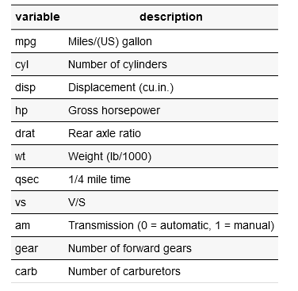
Data frame
The mtcars dataset is a built-in dataset in R. It comprises 11 features (variables) of 32 automobiles (observations) from the 1974 Motor Trend US magazine
#Excercise
mtcars
summary(mtcars$mpg)
plot(mtcars$mpg, mtcars$disp)
plot(mtcars$mpg, mtcars$wt)
library(dplyr)
library(explore)

Slide 70
List
Lists are the most complex of the R data types. Basically, a list is an ordered collection of objects (components)
A list may contain a combination of vectors, matrices, data frames, and even other lists
A list is created using the list() function.

Slide 71
> g <- "My First List"
> h <- c(25, 26, 18, 39)
> j <- matrix(1:10, nrow=5)
> k <- c("one", "two", "three")
> mylist <- list(title=g, ages=h, j, k)
> mylist
$title
[1] "My First List"
$ages
[1] 25 26 18 39
[[3]]
[,1] [,2]
[1,] 1 6
[2,] 2 7
[3,] 3 8
[4,] 4 9
[5,] 5 10
[[4]]
[1] "one" "two" "three"
> mylist[[2]]
[1] 25 26 18 39
> mylist[["ages"]]
[[1] 25 26 18 39
In this example, you create a list with four components: a string, a numeric vector, a matrix, and a character vector.

Slide 72
Pipes
A new paradigm for calling functions in R is the pipe. The pipe from the magrittr package works by taking the value or object on the left-hand side of the pipe and inserting it into the first argument of the function that is on the right-hand side of the pipe.
library(magrittr)
> x <- 1:10
> mean(x)
[1] 5.5
> x %>% mean
[1] 5.5
> z <- c(1, 2, NA, 8, 3, NA, 3)
> sum(is.na(z))
[1] 2
This can also be done using pipes.
> z %>% is.na %>% sum
[1] 2
Pipes read
Pipes read more naturally in a left-to-right fashion, making the code easier to comprehend.

Slide 73
Tips
The period (.) has no special significance in object names.
The dollar sign ($) is used to identify the parts of a data frame or list
R doesn’t provide multiline or block comments. You must start each line of a multiline comment with #.
Indices in R start at 1, not at 0

Slide 75
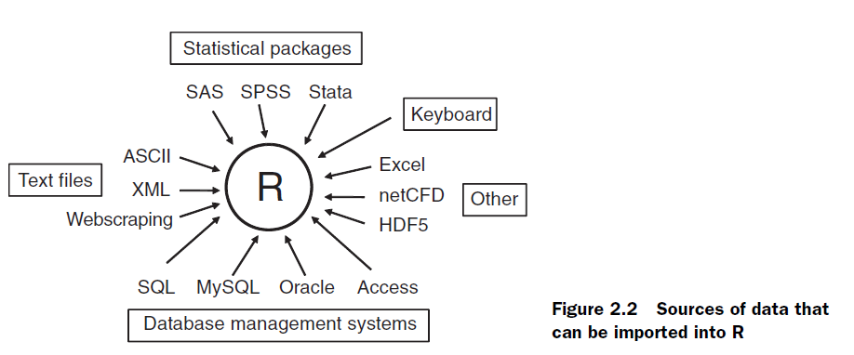
Reading data into R
There are numerous ways to get data, and in numerous formats. The most common one is reading comma separated values (CSV).

Slide 76
Entering data from the keyboard
The edit() function in R invokes a text editor that lets you enter data manually.
Here are the steps:
1 Create an empty data frame (or matrix) with the variable names and modes you want to have in the final dataset.
2 Invoke the text editor on this data object, enter your data, and save the results to the data object.
mydata <- data.frame(age=numeric(0),
gender=character(0), weight=numeric(0))
mydata <- edit(mydata)
Assignments like age=numeric(0) create a variable of a specific mode, but without actual data

Slide 77
Importing data from a delimited text file
Import data from delimited text files using read.table(), a function that reads a file in table format and saves it as a data frame.
mydataframe <- read.table(file, options)
Importing data from a CSV file
Data <- read.csv(“"C:/GIIS/Bis Hazari.csv"”) OR
Data <- read.csv(file.choose(), header=T)

Slide 78
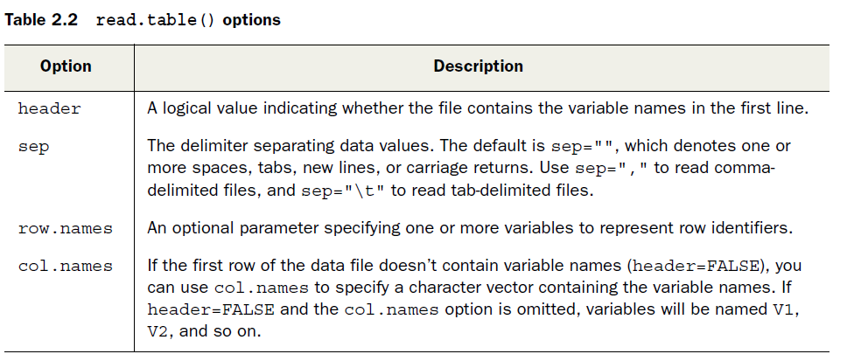
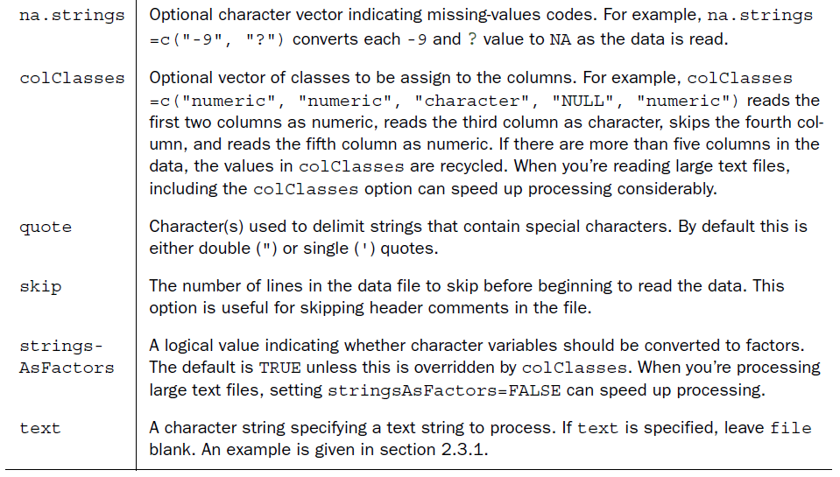

Slide 79
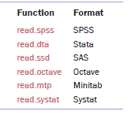
Importing data from Excel
Excel worksheets directly using the xlsx package. You’ll also need the xlsxjars and rJava packages and a working installation of Java (http://java.com)
library(xlsx)
workbook <- "c:/myworkbook.xlsx"
mydataframe <- read.xlsx(workbook, 1)
The foreign package provides a number of functions similar to read.table to read in data from
other tools.
library(readxl)
data <- read_excel("C:/Users/Dell/Downloads/tree data in R training.xlsx", sheet = 2)

Slide 80
Extract Data from Web Sites
If the data are stored neatly in an HTML table, we can use readHTMLTable in the
XML package to easily extract it.
library(XML)
theURL <- "http://www.jaredlander.com/2012/02/another-kind-of-super-bowl-pool/"
bowlPool <- readHTMLTable(theURL, which=1, header=FALSE, stringsAsFactors=FALSE)
bowlPool
theUrl <- "http://www.jaredlander.com/data/TomatoFirst.csv"
tomato <- read.table(file=theUrl, header=TRUE, sep=",")
head(tomato)

Slide 81
Extract Data from Web Sites
Data can be obtained from the web via webscraping or the use of application programming interfaces (APIs). Webscraping is used to extract the information embedded in specific web pages, whereas APIs allow you to interact with web services and online data stores.
For example, if you’re interested in social media, you can access Twitter data via twitteR, Facebook data via Rfacebook, and Flickr data via Rflickr

Slide 82
Importing data from NetCDF
Unidata’s Network Common Data Form (NetCDF) open source software contains machine-independent data formats for the creation and distribution of array-oriented scientific data. NetCDF is commonly used to store geophysical data
The ncdf package provides support for data files created with Unidata’s NetCDF library
library(ncdf)
nc <- nc_open("mynetCDFfile")
myarray <- get.var.ncdf(nc, myvar)

Slide 83
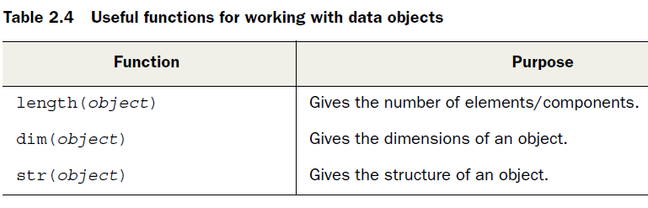
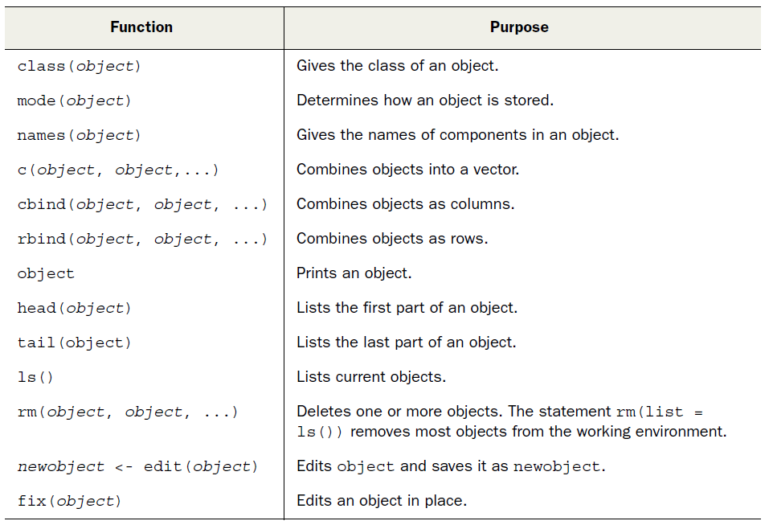
Useful functions for working with data objects

Slide 84
Export Data from R (csv , txt and other formats)
write.csv(df, "C:/Users/Bob/Desktop/data.csv")
help(write.csv) or ?write.csv
write.table(df, "C:/Users/Bob/Desktop/data.csv", row.names=FALSE)

Slide 86
Control Structures in R
In order to control the execution of the expressions flow in R, we make use of the control structures.
These control structures are also called as loops in R.
There are eight types of control structures in R:
if
if-else
for
nested loops
while
repeat and break
next
return

Slide 87
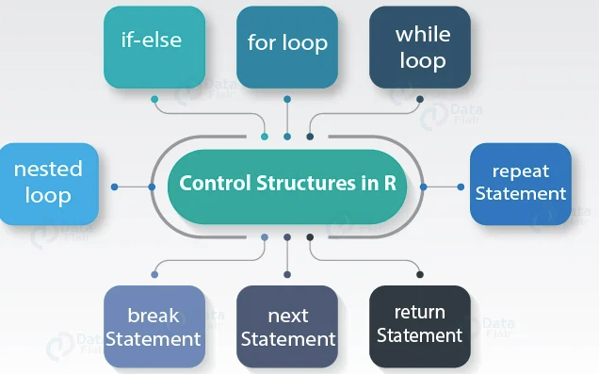
List of R Control Structures with Examples
Source: R-bloggers.com

Slide 88
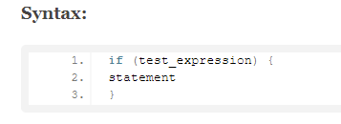
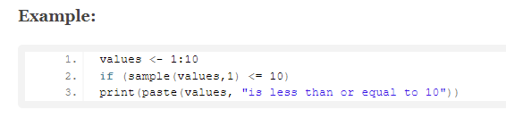
if Condition in R
This task is carried out only if this condition is returned as TRUE. R makes it even easier: You can drop the word then and specify your choice in an if statement.

Slide 89
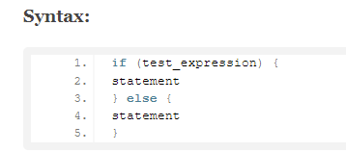
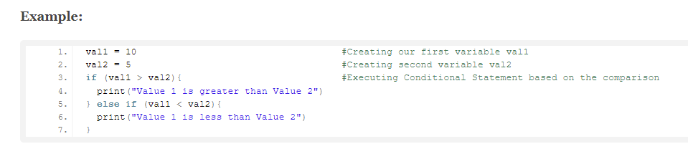
if-else Condition in R
An if…else statement contains the same elements as an if statement (see the preceding section), with some extra elements:
The keyword else, placed after the first code block.
The second block of code, contained within braces, that has to be carried out, only if the result of the condition in the if() statement is FALSE.

Slide 90
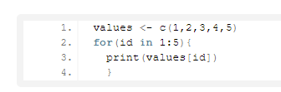
for Loop in R
A loop is a sequence of instructions that is repeated until a certain condition is reached. for, while and repeat, with the additional clauses break and next are used to construct loops.
Example:
These control structures in R, made of the rectangular box ‘init’ and the diamond. It is executed a known number of times. for is a block that is contained within curly braces.

Slide 91
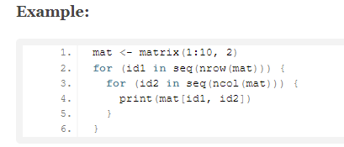
Nested Loop in R
It is similar to the standard for loop, which makes it easy to convert for loop to a foreach loop.
Unlike many parallel programming packages for R, foreach doesn’t require the body of for loop to be turned into a function. We can call this a nesting operator because it is used to create nested foreach loops.

Slide 92
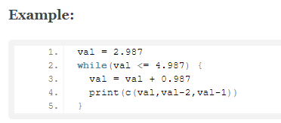
while Loop in R
The format is while(cond) expr, where cond is the condition to test and expr is an expression.
R would complain about the missing expression that was supposed to provide the required True or False and in fact, it does not know ‘response’ before using it in the loop.

Slide 93
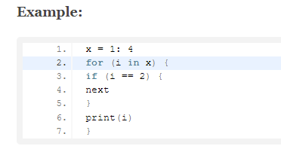
next Statement in R
next jumps to the next cycle without completing a particular iteration. In fact, it jumps to the evaluation of the condition holding the current loop. Next statement enables to skip the current iteration of a loop without terminating it.

Slide 94



return Statement in R
Many times, we will require some functions to do processing and return back the result. This is accomplished with the return() statement in R.

Slide 95
Summary
Control Structures in R are the backbone of any programming language, as it changes the flow of the program.
In this R training session, we have studied in detail about the control statements along with its syntax and uses and how to operate these loops with different control structures.

Slide 96

Functions in R
Now, it’s time to uncover one of the most essential concepts of R programming that is R function

Slide 97

Transforming the Script into R Function
Firstly, define a function with a name so that it becomes easier to call an R function and pass arguments to it as input.
The R function should be followed by parentheses that act as a front gate for your function and between the parentheses, arguments for the function are provided.
Use the return() statement that acts as a back gate of your function.
The return() statement provides the final result of the function that is returned to your workspace.
Let us now see how we can convert the script that we had written earlier to convert values into percentage and round off into an R function.

Slide 98
The keyword function defines the starting of function. The parentheses after the function form the front gate, or argument list of the function. Between the parentheses are the arguments to the function. In this case, there is only one argument.
The return statement defines the end of the function and returns the result. The object put between the parentheses is returned from inside the function to the workspace. Only one object can be placed between the parentheses.
The braces, {} are the walls of the function. Everything between the braces is part of the assembly line or the body of the function. This is how functions are created in R.

Slide 99

Using R Function
As R does not let you know by itself that it loaded the function but it is present in the workspace, if you want you can check it by using ls() command.
After transforming the script into an R function, you need to save it and you can use the function in R again if required.
As R does not let you know by itself that it loaded the function but it is present in the workspace, if you want you can check it by using ls() command.
Now as we know what all functions in R are present in the memory and we can use it when required.
For example, if you want to create percentage from values again, you can use add percent function for the same as below:

Slide 100

Vector Functions
We are going to discuss R vector functions in this tutorial. They are the functions that can be applied over R vectors.

Slide 101
What are R Vector Functions?
First of all, let’s discuss what exactly a function means. In order to perform a particular task, we make use of the function, which is a piece of code in R. In R, these functions are referred to as the objects as they facilitate the similar way of functioning like other types of objects. Functions that we use in R vectors are known as the vector functions.
For example: rep(), seq(), using all() and any(), more on c() etc.

Slide 102
R rep() Function
rep() is used for replicating the values in x. The two common cases that exhibit faster-simplified versions are rep.int and rep_len. Furthermore, these functions are not generic.
You can use the rep() function in several ways if you want to repeat the complete vector.
To repeat the vector c(0, 0, 7) three times, use this code: rep(c(0, 0, 7), times = 4)
We can also repeat every value by specifying each argument, like this: rep(c(2, 4, 2), each = 2)
For each value, we can tell R how often it has to repeat: rep(c(0, 7), times = c(4,3))
In seq, we use the argument, length.out to define R. It will repeat the vector until it reaches the specified length, even if the last repetition is incomplete. rep(1:3,length.out=9)

Slide 103
R seq() Function
It generates regular sequences. The seq function is standard generic in nature that also has a default method. seq.int poses a few restrictions due to its primitiveness but it is also much faster. The two common cases that exhibit fast primitives are seq_along and seq_len.
To create a list of vectors over a specified range, we use the colon (:) symbol. The code 1:5 gives you a vector with the numbers 1 to 5, and 2:–5 create a vector with the numbers 2 to –5.
Using the seq(), we make steps in a sequence. Seq() function is used to describe the intervals by which numbers should decrease or increase. : seq(from = 4.5, to = 3.0, by = -0.5)
You can specify the length of the sequence by using the argument, length.out. Afterwards, R can calculate the step size by itself.: seq(from = -2.7, to = 1.3, length.out = 9)

Slide 104
R any() Function
It takes the set of vectors and returns a set of logical vectors, in which at least one of the value is true.
Check if any or all the elements of a vector are TRUE. Both functions also accept many objects. : any(…, na.rm=FALSE)
Here,
… means one or more R objects that need to be checked.
na.rm means state whether NA values should be ignored or not.

Slide 105

R all() Function
It takes the set of vectors and returns a set of logical vectors, in which all of the values are TRUE.
all(…, na.rm=FALSE)
Here,
… means one or more R objects that need to be checked.
na.rm means state whether NA values should be ignored or not.

Slide 106
Summary
We have discussed vectors and functions over the vectors in detail. A vector is a type of datatype and has its own importance. But, using a datatype with function totally changes its meaning and use. We have to develop a code using function only once and you can use that code anytime. There is no need to write code, again and again, as the larger program will store it in two or more functions.

Slide 107

Numeric and Character Functions in R
We will learn about R built-in functions, in which we will focus on different types of numeric and character functions in R. Along with this, we will also understand different types of properties of character functions.

Slide 108
R Numeric Functions
We use R built-in functions to perform almost everything in R. Here we are only referring to numeric and character functions that are generally used in creating or recording variables.
Function Description
abs(x) absolute value
ceiling(x) ceiling(3.475) is 4
sqrt(x) square root
floor(x) floor(3.475) is 3
log(x) natural logarithm
trunc(x) trunc(5.99) is 5
round(x, digits=n) round(3.475, digit=2) is 3.48
log10(x) common logarithm
signif(x, digits=n) signif(3.475, digit=2) is 3.5
exp(x) e^x
cos(x), sin(x), tan(x) also acos(x), cosh(x), acosh(zx) etc

Slide 109
Character Functions in R
1. grep(pattern, x , ignore.case=FALSE, fixed=FALSE)
Description:
Search for a pattern in x.
If fixed =FALSE, then the pattern is a regular expression.
If fixed=TRUE, then the pattern is a text string.
Returns matching indices.
grep("A", c("b", "A", "c"), fixed = TRUE)
2. substr(x, start=n1, stop=n2)
Extract or replace substrings in a character vector.

Slide 110
Character Functions in R
3. strsplit : strsplit("abc", "")
4. sub(pattern, replacement, x, ignore.case =FALSE, fixed=FALSE) : sub("S","M","Surkhet")
Description:
Find a pattern in x and replace it with the replacement text.
If a fixed = FALSE, then a pattern is a regular expression.
If fixed = TRUE, then a pattern is a text string.
5.toupper(string)
6. tolower(string)
7. paste(…, sep=””)

Slide 111
Character Functions in R
8. Concatenate Strings in R : In order to join the two strings (also known as concatenation), we make use of the paste function. It is one of the most important strings manipulation task. Every analyst performs it almost daily to structure the data. (paste (objects, sep = " ", collapse = NULL))
sep – Keyword which denotes a separator or delimiter.
default separator – A single space.
collapse – Keyword which is used to separate the results.
9. String Formatting in R : Suppose the value is stored in fraction and you need to convert it to percentage. In order to format our string in a C-style, sprintf function is used. (sprintf(fmt, ...)
10. String Length (nchar(x))
11. Repeat the character N times (strrep(“Nepal ", 5))

Slide 112
Matrix Function in R
We are going to cover the functions that are applied to the matrices in R i.e. apply() and sapply() function. Also, we will see how to use these functions of the R matrix with the help of examples.
First of all, let’s revise what are matrices. A matrix is a two-dimensional rectangular data set. Thus it can be created using vector input into the matrix function. Also, a matrix is a collection of numbers arranged into a fixed number of rows and columns.
The numbers present in the matrix are real numbers.
We then carry out the memory replication of the matrix using the matrix function. Hence, the data elements must be of the same basic type.
There are two types of matrix function in R:
apply()
sapply()

Slide 113

apply() function in R
It applies functions over array margins. It returns a vector or array or list of values obtained by applying a function to margins of an array or matrix.
Keywords – array, iteration
Usage – apply(X, MARGIN, FUN, …)
Apply functions are a family of functions in base R, which allow us to perform actions on many chunks of data. An apply function is a loop, but it runs faster than loops and often with less code. And, there are different apply() functions.
Apply() functions family : apply(), lapply(), sapply(), tapply() (Ref : apply() source link
Source : https://www.guru99.com/r-apply-sapply-tapply.html

Slide 114
sapply() function in R
It is a dimension preserving variant of “sapply” and “lapply”.
sapply is a user-friendly version and is a wrapper of lapply. By default, sapply returns a vector, matrix or an array.
Arguments – The arguments used in the sapply() function are discussed below:
X – It is a vector or list to call sapply.
FUN – A function.
… – Optional arguments to FUN.
simplify – It is a logical value which defines whether a result is simplified to a vector or matrix (if possible).
USE.NAMES – Logical; if it is TRUE and X is a character, then use X as names for the result unless it has names already.

Slide 115

Various types of functions in the apply family
Source : https://subscription.packtpub.com/book/application-development/9781786465153/1/ch01lvl1sec11/first-class-functions-in-r

Slide 116
END of Day 1 Training Session!!

